Slide 1
Why do countries accumulate foreign reserves?
Prepared by
Ramon Moreno and Serge Jeanneau
FLAR Workshop on Reserve Management
Lima, Peru

Slide 2
“The reserves are primarily there in case we are
called upon to use them; managing them for
added return is merely what we do until they are
needed.”
Bank of England senior official
Quoted by John Nugee, State Street Global Advisors
In Central Banking, Vol. XIII.1, August 2002
Notes:
IIF estimates

Slide 3
Outline
Overview of long-term evolution of global FX reserves
Why are FX reserves up?
  Shift to C/A surpluses and renewed capital inflows
  Intervention to prevent appreciation
  Accumulation for precautionary purposes
Look at key FX reserve ratios
Statistical determinants of FX reserves
Costs and benefits of holding FX reserves
Issue of currency mismatch

Slide 4
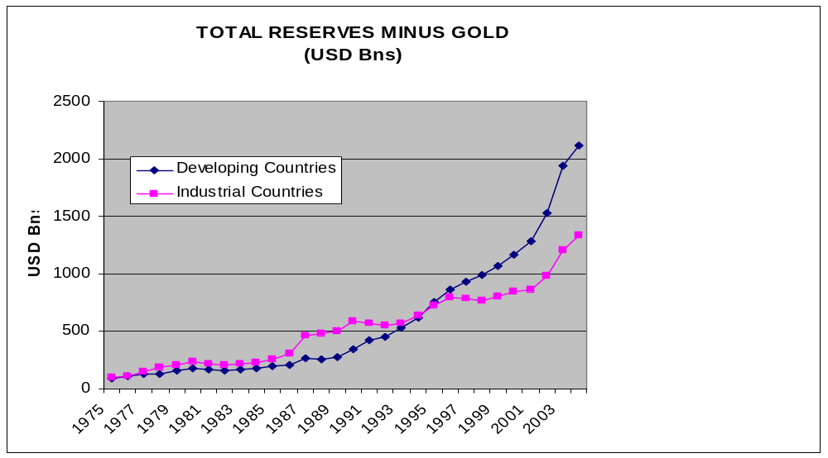
Long-term evolution of global FX reserves

Slide 5
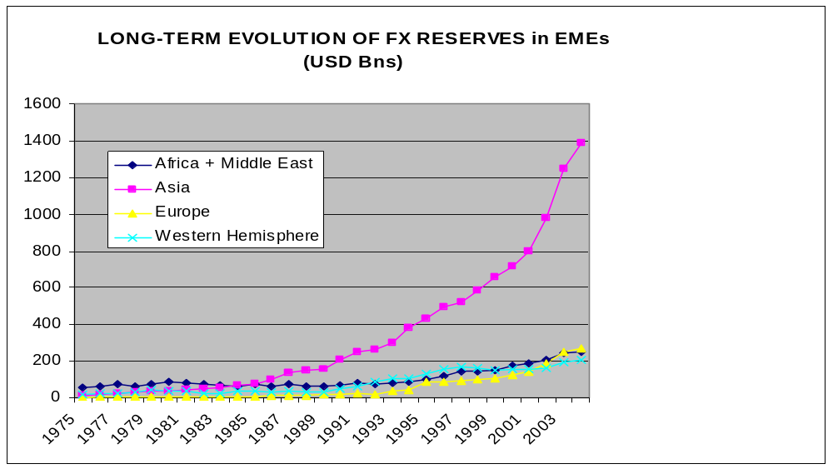
Long-term evolution of FX reserves in EMEs

Slide 6
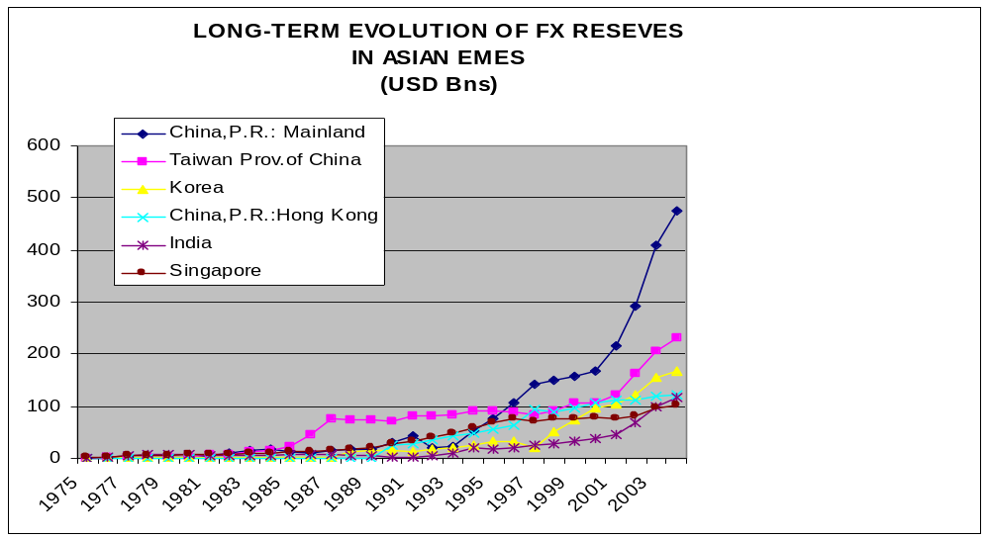
Long-term evolution of FX reserves in Asian EMEs

Slide 7
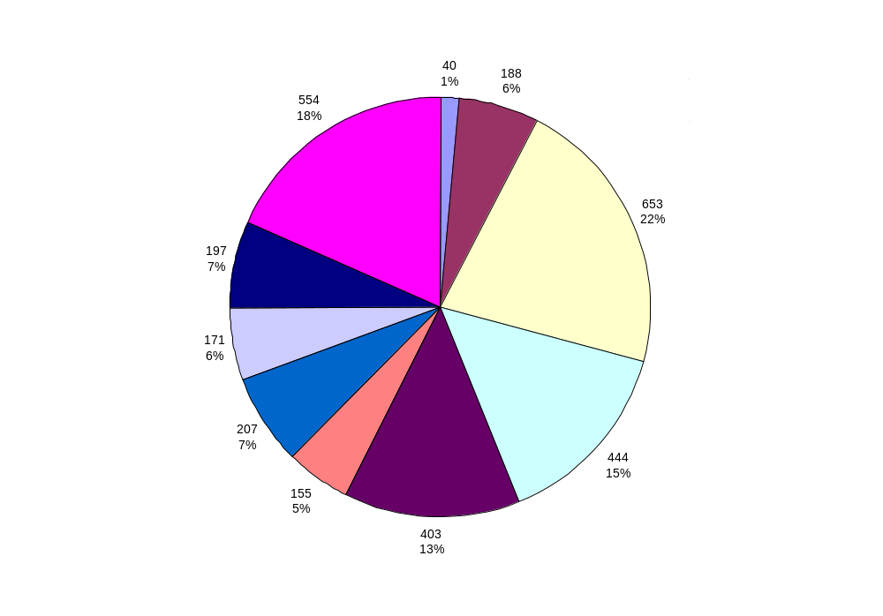
Japan and Emerging Asia account for nearly 2/3 of FX reserves at end-2003
US$ billions and %
Notes:
Japan and emerging Asia account for 2/3 of global foreign reserves.
Note: India’s reserves
Latin America had fairly small reserves. However, reserves are significant in Mexico ($57 billion) followed by Brazil (

Slide 8
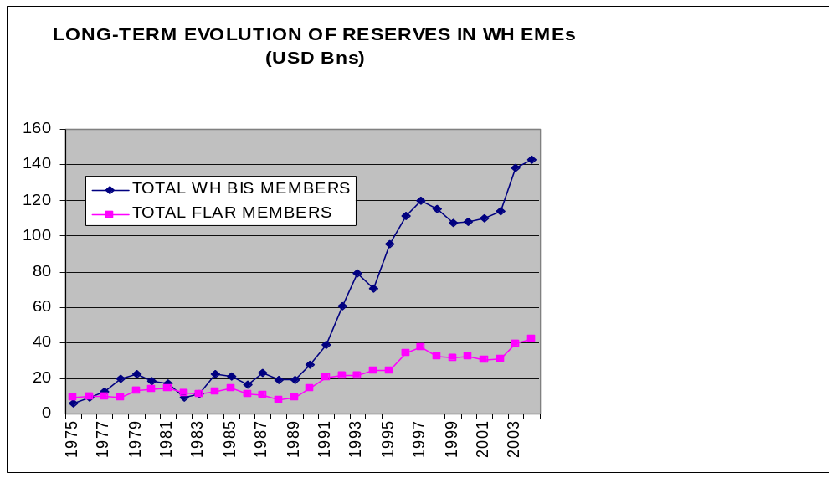
Long-term evolution of FX reserves in WH EMEs

Slide 9
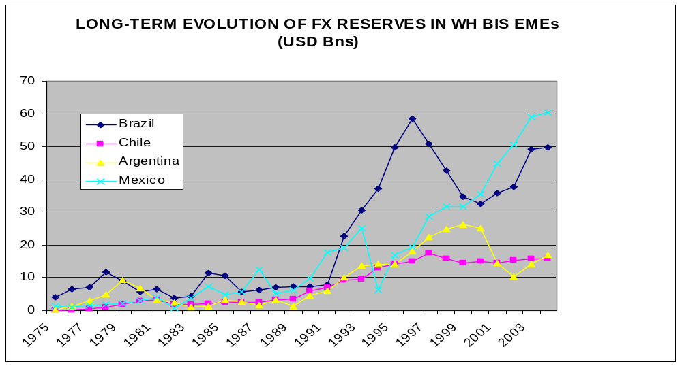
Long-term evolution of FX reserves in WH BIS EMEs

Slide 10
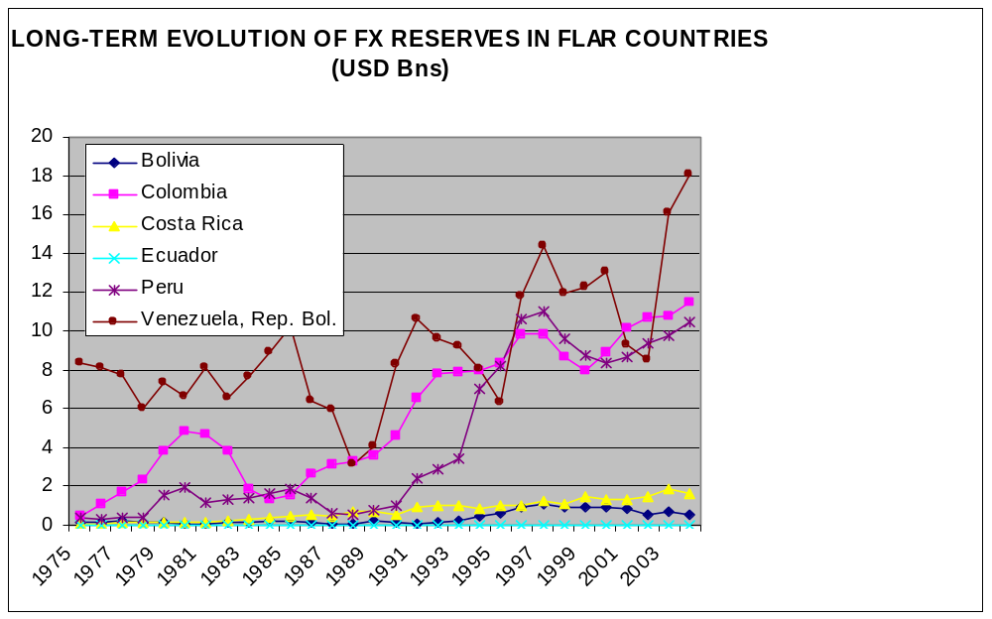
Long-term evolution of FX reserves in FLAR countries

Slide 11
Why have FX Reserves Risen by so Much?
Shift to EMEs’ current account surpluses and upsurge in net capital inflows.
Intervention to stabilize exchange rate, specifically to prevent exchange rates from appreciating.
  Revived Bretton Woods System (Dooley, Folkerts Landau and Garber, 2003 and Eichengreen, 2004).
Intervention to accumulate enough FX reserves available to
  Prevent runs/crises.
  Supply liquidity for transactions (eg for imports or exports, to make the FX market two-sided – reduce exchange rate volatility).
Notes:
IIF estimates

Slide 12
“Supply” of foreign reserves reflects balance of payments conditions
Current Account
+Capital & Financial Account (FDI, Portfolio, Other)
+Net errors and omissions
=Changes in Reserves
Get change in foreign reserves as long as central bank intervenes to buy foreign currency.
Foreign exchange surrender requirements at a set price have the same effect.
Notes:
Capital account:
Capital transfers and acquisition/disposal of nonproduced, nonfinancial assets
Ie transfers of ownership of fixed assets; of funds linked to or conditional upon acquisition or disposal of fixed assets or cancellation without any counterparts being received in return of liabilities by creditors
Two components (i) general government, subdivided into debt forgiveness and other and (ii) other subdivided into migrants’transfers, debt forgiveness and other transfers.
Acquisition/disposal of nonproduced, nonfinancial assets: intangibles such as patented entities, leases or other tranferable contracts, goodwill etc. Does not cover land in a specific economic territory but may include the purchase or sale of land by a foreign embassy
Financial account: all components classified by type of investment or by functional breakdown

Slide 13
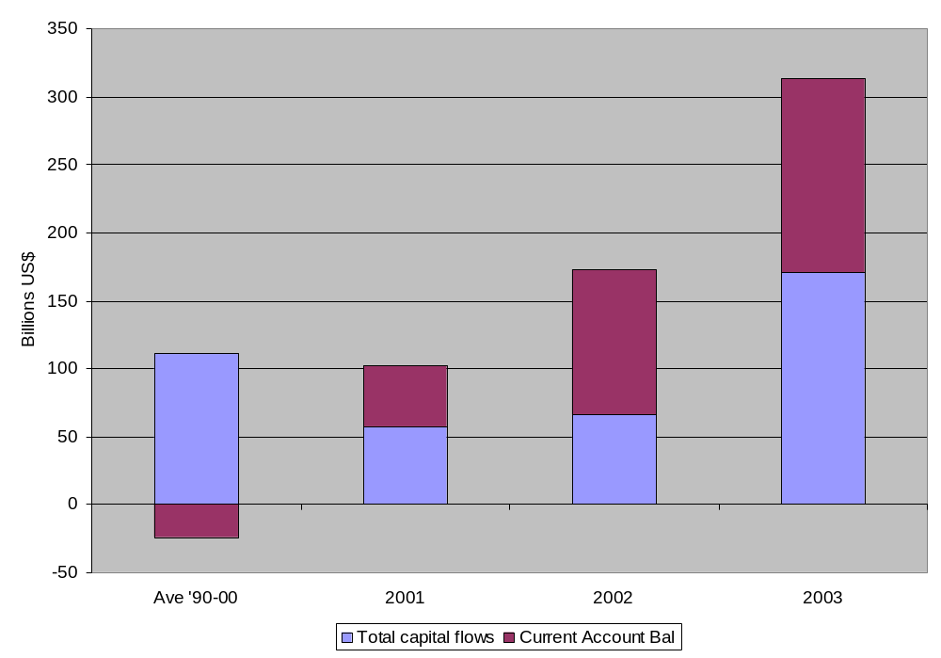
“Supply” of foreign reserves in emerging markets has risen sharply
Notes:
Current accounts turned into surpluses
Financial account surpluses have grown and now exceed the average for the 1990s
Capital account surpluses were roughly balanced a sources of foreign reserve accumulation in 2003.

Slide 14
Intervention to prevent appreciation (Asia)
“Revived Bretton Woods”, US is centre of world financial system. Dooley, Folkerts-Landau, Garber, 2003, “An Essay on the Revived Bretton Woods System”. NBER Working Paper No. 9971.
Two types of countries in periphery, trade and capital account countries.
“Trade account countries” intervene to prevent exchange rate appreciation.
Goal: stimulate exports, investment and growth. Japan also tolerates more depreciation than appreciation – to end sluggish growth.
If this results in balance of payments surpluses: happy to buy US securities regardless of risk/return considerations because they want to boost growth.
Predictions:
  Should see less currency appreciation and greater FX reserves in trade account countries.
  Should see more FDI and exports in such countries.
  No incentive to switch reserves to euro since such a shift would weaken the dollar and lead to an appreciation of their own currencies against it. To avoid this they will intervene and buy more dollars, nullifying the shift.
Notes:
IIF estimates

Slide 15
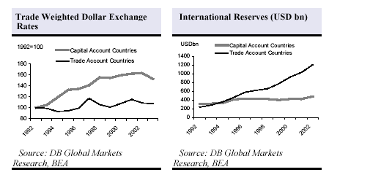
Exchange rate and foreign reserve trends
Less appreciation and greater reserves in trade account countries. Source:
Dooley et al.

Slide 16
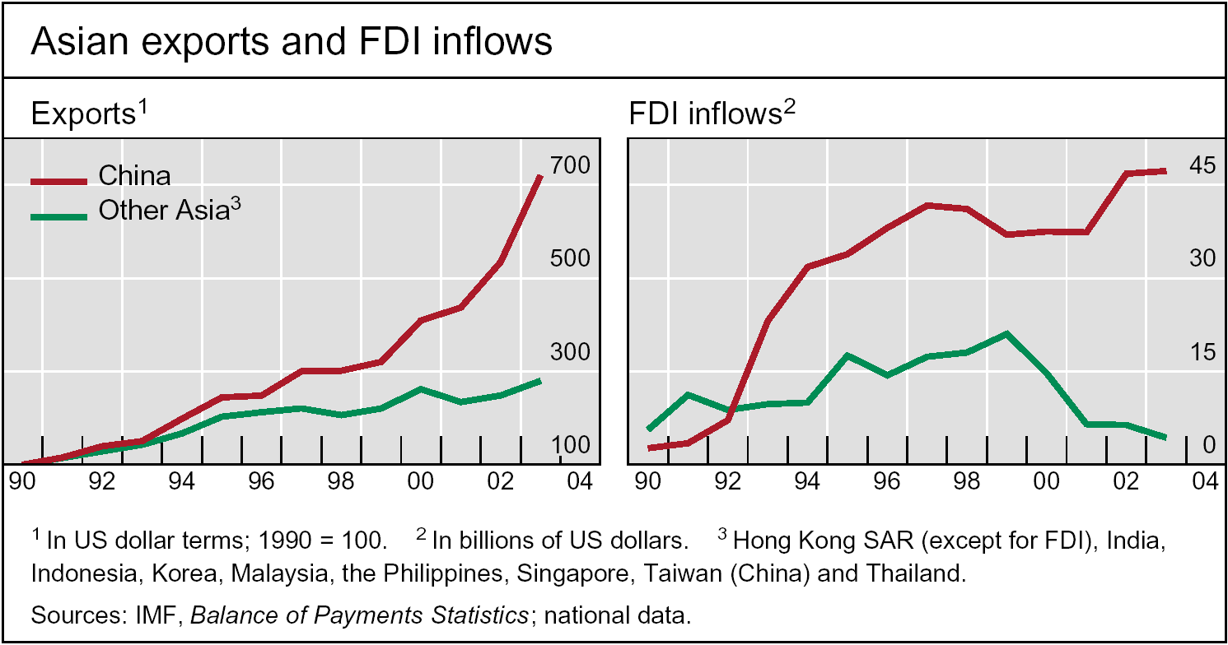
China has accounted for a large proportion of global export growth and FDI inflows. However, the trading account hypothesis may not apply to all countries
Notes:
IIF estimates

Slide 17
Factors putting pressure on “trade account” strategy
Inflationary pressures.
  Accumulating reserves is potentially inflationary. If do not sterilise and foreign reserves accumulate, the ensuing increase in base money may cause domestic inflation or an asset price boom. If sterilise, domestic rates may remain high relative to foreign rates attracting more foreign capital and prompting more reserve accumulation and money growth.
  Problem of “impossible trinity”: with an open capital account a country cannot precisely target the exchange rate and conduct an independent monetary policy.
Concerns that capital inflows could reverse.
  For example, in the spring of 2004 global interest rates rose and spreads increased. Trying to peg or stabilize exchange rate created upward pressures on domestic interest rates, potentially harming growth or creating concerns about its sustainability.

Slide 18
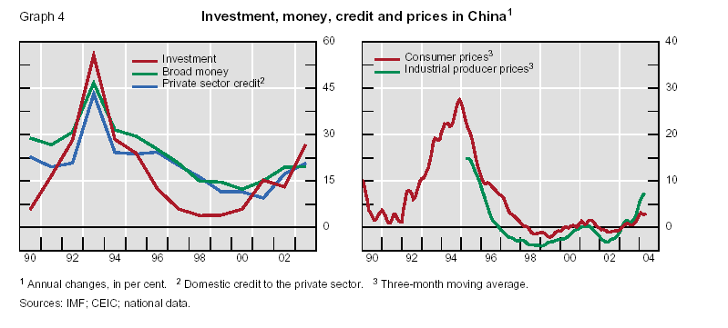
China: Pegging is leading to rapid money and credit growth and rising inflation

Slide 19
Precautionary accumulation of FX reserves
Reserve demand or possible calls on reserves
Import payments (3-6 months)
M2 (proposed by Calvo, 1996 after Mexico crisis)
Short-term foreign currency debt (Guidotti-Greenspan rule, 1 year cover): research by Bussiere and Mulder (1999) estimate ratio of 1 prevents crisis in three periods of external financing pressure (Korea a good example)
Total debt (if financing problems extend for more than 1 year)
Preceding 3 are means for preventing crises
Notes:
IIF estimates

Slide 20
RESERVE INDICATORS
 | Reserves/imports¹ |  | Reserves/broad money |  | Reserves/short-term debt² |  | Reserves/total debt³
 | 1997 | 2003 | 1997 | 2003 | 1997 | 2003 | 1997 | 2003
Emerging Asia⁴ | 9 | 12 | 13 | 21 | 282 | 878 | 99 | 394
China | 12 | 12 | 13 | 15 | 392 | 1300 | 139 | 583
India | 7 | 17 | 12 | 26 | 305 | 598 | 94 | 289
Philippines | 2 | 4 | 14 | 30 | 56 | 132 | 25 | 31
Thailand | 5 | 7 | 19 | 30 | 66 | 404 | 33 | 152
Latin America⁴ | 8 | 10 | 30 | 37 | 107 | 166 | 43 | 41
Brazil | 10 | 12 | 23 | 37 | 92 | 124 | 46 | 38
Mexico | 3 | 4 | 16 | 18 | 87 | 165 | 26 | 44
Peru | 15 | 14 | 65 | 54 | 160 | 164 | 109 | 76
Venezuela | 12 | 21 | 82 | 82 | 260 | 495 | 78 | 69
Central Europe⁴ | 6 | 6 | 36 | 38 | 400 | 285 | 137 | 73
Russia | 2 | 12 | 16 | 57 | 39 | 284 | 16 | 98
South Africa | 2 | 2 | 7 | 7 | 34 | 63 | 19 | 20
Turkey | 5 | 6 | 27 | 34 | 95 | 148 | 44 | 54
¹ Months of imports. ² Foreign reserves as a percentage of international debt securities and liabilities to BIS reporting banks with maturity of less than one year. ³ Foreign reserves as a percentage of International debt securities and liabilities to BIS reporting banks. ⁴ Weighted average of Czech Republic, Hungary and Poland based on 2000 GDP and PPP exchange rates. Sources: IMF; BIS; national data.
Notes:
Large increases in ratios of reserves to debt, except in CEE. Why not?
More moderate increase in ratio of reserves to imports or reserves to M2

Slide 21
IMF analysis of determinants of FX reserves
Simple regressions of reserves on each factor.
Reserves will be larger if a country is:
  (1) larger (higher real GDP per capita or population).
  (2) is more open as measured by imports to GDP.
  (3) has more volatile export revenues.
Reserves will be lower if:
  (1) country has more flexible exchange rates (ie floating) or
  (2) if the costs of holding reserves are higher.

Slide 22
WEO Sept. 03 T. 2.2. Simple Regressions of Reserves on Explanatory Variables (Sample: emerging economies, 1980–96)
Economic size
Real GDP per capita | 1.63**
Population | 2.37**
Current account vulnerability
Ratio of imports to GDP | 0.57**
Trade openness | 0.16
Export volatility | 0.11+
Capital account vulnerability
Financial openness | 0.18
Ratio of broad money to GDP | 0.15
Exchange rate flexibility
Exchange rate volatility | –0.01**
Opportunity cost
Nominal interest rate differential | –0.01**
Real interest differential | –0.01**
Source: IMF staff estimates. Notes: All regressions include fixed effects; + denotes significance at 10 percent; * significance at 5 percent; and ** significance at 1 percent.
Notes:
IIF estimates

Slide 23
IMF analysis of determinants of FX reserves
More complete specification.
  Same variables. All work, except export revenues and the cost of holding reserves.
Explains a very large proportion of variation in reserves.

Slide 24
WEO Sept. 03 T. 2.3. Multiple-Variable Regression Results for Reserves (Sample: emerging economies, 1980–96)
 | Dependent Variable: Real Reserves
Real GDP per capita | 1.44
 | (6.23)**
Population | 1.98
 | (4.85)**
Imports to GDP | 0.44
 | (3.58)**
Export volatility | 0.09
 | (0.92)
Exchange rate volatility | –0.01
 | (2.02)*
No. obs. 1692 | R² 0.91
Source: IMF estimates based on country fixed effects and a constant. Notes: Robust t statistics in parentheses; * denotes significance at 5 percent; ** denotes significance at 1 percent.
Notes:
IIF estimates

Slide 25
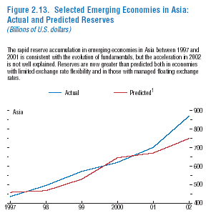
Asia: reserves larger than predicted

Slide 26
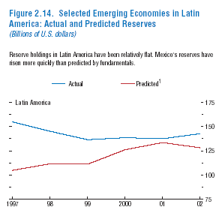
Latin America: reserves above predicted…

Slide 27
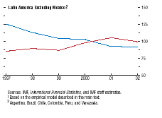
…largely because of Mexico

Slide 28
Costs of holding foreign reserves
Ultimately an economic concept
  BoP surplus invested in low-yielding foreign assets: give up return from investing in higher-yielding domestic investment projects.
Opportunity cost proxy
  Yield on domestic debt instrument (preferably long- term) as a proxy for opportunity cost.
  Subtracts (typically lower) return on foreign reserves.
To be set against benefits
  Cost might be offset if higher foreign reserves imply higher sovereign credit ratings and lower sovereign spreads.
Notes:
IIF estimates

Slide 29
Illustrative graphs
China based on long term rates.
For other countries short term domestic interest rate versus US 3-month t-bill rate applied to net foreign assets as % of GDP. Probably understate costs.
Graphs purely illustrative. Focus on cross country comparisons and trends

Slide 30
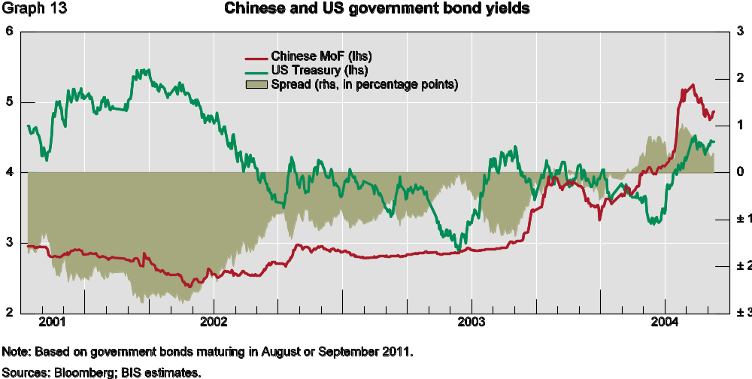
Until this year, cost of carrying foreign reserves in
China was negative. China was making money from sterilising!
Notes:
IIF estimates

Slide 31
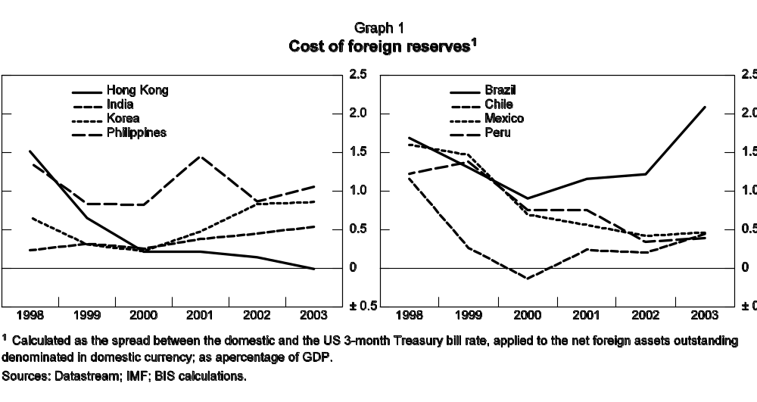
Note: Applying simple interest spread to NFAs in previous period.
Shows that costs are generally positive. Low in Hong Kong and high in Brazil.
Notes:
IIF estimates

Slide 32
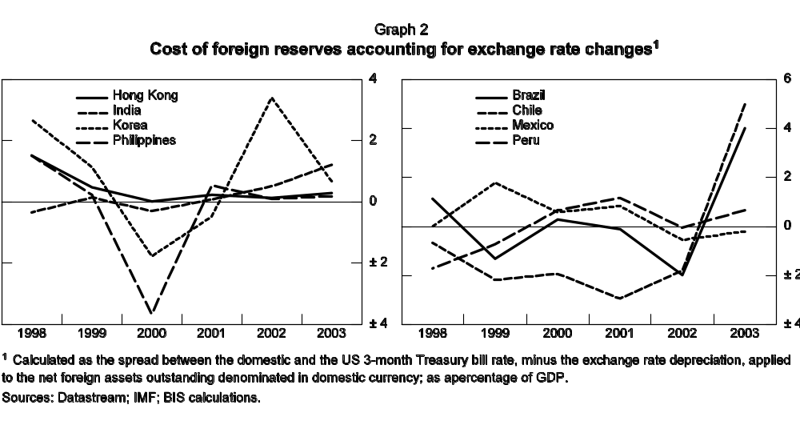
Note: Capital gains from exchange rate depreciation changes picture considerably (if recognised), eg costs negative in 2002 in Brazil
Notes:
IIF estimates

Slide 33
Is the cost of higher foreign reserves offset by lower sovereign spreads?
Higher external debt to exports appears to be associated with lower ratings and higher sovereign spreads
  Average sovereign spreads: January 2002-present: highest in those countries with highest debt to exports
  Sovereign spread increases: April-mid May 2004 – highest in those countries with higher external debt to exports
Does an increase in FX reserves reduce spreads given external debt to exports?
  Some recent BIS research indicates that this might be detected if one uses a broad enough sample.
Notes:
IIF estimates

Slide 34
Reserves can help reduce economy-wide currency mismatches
Currency mismatches: foreign currency liabilities exceed foreign currency assets or are not offset by earning potential in hard currencies.
If the currency devalues sharply, firms might go bankrupt or government faces rising debt burden as foreign currency liabilities rise more than foreign assets
This can result in crises and severe output contraction
By reducing overall mismatches larger FX reserves might reduce the contractionary effects of a depreciation
Importance of looking at consolidated B/S of country

Slide 35
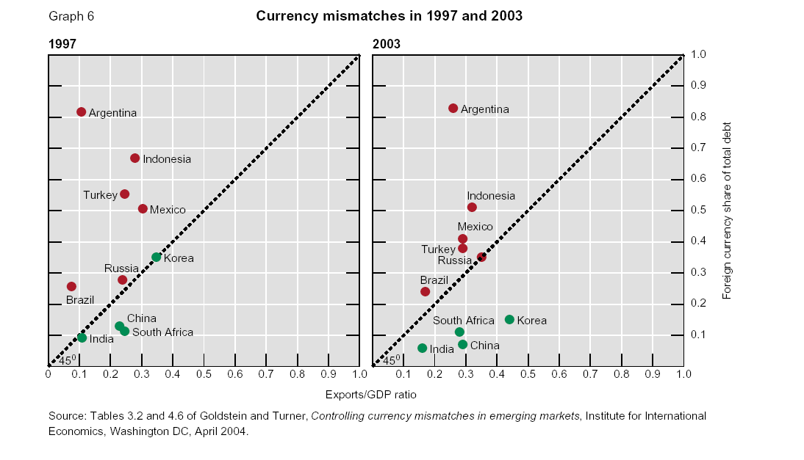
Notes:
Exchange rate-linked debt and currency mismatches
Many countries issue debt in foreign currency, or indexed to foreign currency, in an effort to reduce costs of financing. Foreign currency-linked debt instruments are sometimes used for hedging by the private sector when the private supply of securities denominated in hard currency is limited. A positive development is that a number of heavily indebted economies are now less vulnerable to currency depreciation by this channel. The ratio of foreign currency-linked debt to the total has fallen significantly in a number of important borrowers, notably in Brazil. However, it remains high in Turkey, Indonesia and the Philippines (Table A3). More generally, a country’s vulnerability to external shocks, and perceptions of the sustainability of its public debt, depends crucially on the currency of denomination of its total debt, whether public or private. One example serves to illustrate the two magnitudes involved. Because of its heavy reliance on exchange rate-linked debt, Brazil’s, exchange rate depreciation is estimated to have increased its public debt ratio by nearly 20% of GDP since the mid 1990s. In many other countries (Mexico in 1994 and Indonesia in 1997), it has been the foreign currency debts of private firms with local currency earnings that have caused disruption when the exchange rate depreciated.
Any assessment of debt sustainability therefore needs to take account of currency mismatches – how far foreign currency debt (including that between domestic agents) is covered by foreign currency earnings.5 To put the point at its most measurable: countries with high export/GDP ratios can sustain
higher foreign currency shares in total debt. These two ratios are charted in Graph 6. Countries shown above the 45° line have a foreign currency share in total debt that is greater than their export/GDP ratio. The further countries are away from the 45° line, the greater is the degree of currency mismatch.
Mismatches were particularly large in 1997 (Graph 6 left-hand panel). Most Asian countries, however, have in recent years reduced their dependence on foreign currency debt and increased foreign currency earnings: Korea is now well below the 45° line. In Indonesia and Mexico, the foreign currency share of total debt (both public and private) has also fallen substantially in recent years. While there are still significant currency mismatches, preliminary calculations suggest that a number of countries – notably Brazil and Turkey – moved closer to the 45° line in 2003. One major positive development deserves note: the decline in foreign exchange-linked debt in Brazil, which now accounts for less than 20% of total federal public debt, compared with over 40% in late 2002.

Slide 36
Action plan to control currency mismatches
(Goldstein and Turner)
Managed floating rate regime (to produce an awareness of currency risk).
Inflation targeting regime (to produce stability in L-T inflation expectations, important in developing a healthy bond market).
Regular publication of data on currency mismatch at the sectoral and economy-wide level (to enhance market discipline).
Stepped-up supervision and monitoring of currency mismatches at banks (to limit losses to tolerable levels).
Changes in official safety nets and IMF conditionality (to limit expectations of bailouts).
Implementation of more prudent debt and reserve management policies.
Higher priority to developing domestic bond markets, hedging instruments and reducing entry barriers to foreign banks.

Slide 37
Concluding remarks
Discussed broad factors in the “supply” of foreign reserves:
  shift to current and capital account surpluses.
  intervention to prevent appreciation.
  Precautionary motive (to help prevent crises and ensure liquidity).
Looked at some of the statistical determinants of reserves.
Reviewed costs and benefits of foreign reserves.
Addressed the need to reduce currency mismatch

